Slide 1
Bits, Bytes, Ints
Jinyang Li
Some are based on Tiger Wang’s slides

Slide 2
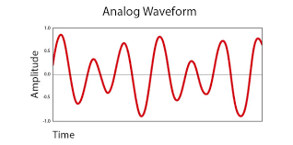

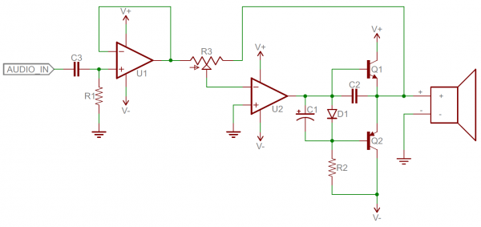
The language of electronics has evolved from analog signals…
Analog signals: smooth and continuous
Problems
Difficult to design
Susceptible to noise
Analog components: resistors, capacitors, inductors, diodes, etc.

Slide 3
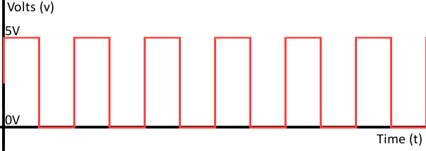

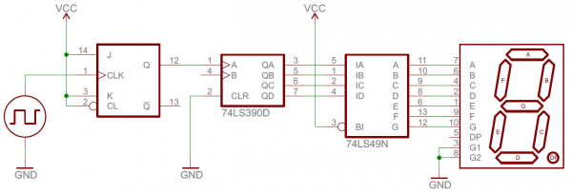
… to digital
1 0 1 0 1 0 1 0 1 0 1 0
Digital signals: discrete (encode sequence of 0s and 1s)
Advantages
Easier to design
Robust to noise
Digital components: transistors, logic gates …

Slide 4
Using bits to represent everything
Bit = Binary digit, 0 or 1
A bit is too small to be useful
A bit has 2 values; the English alphabet has 26 values (characters)
Use a group of bits instead of bit
different bit patterns represent different “values”

Slide 5
Question
How many bit patterns can a group of 2 bits have?
Can be
either 0 or 1
b₁
b₀
All patterns of 2-bits: 00, 01, 10, 11
How many bit patterns does a group of n bits have?
b_{n-1}b_{n-2}...b₁b₀
# of patterns of n-bits: 2^{n}
n bits

Slide 6
A digression: you must memorize common powers of 2
2⁰ = 1
2¹ = 2
2² = 4
2³ = 8
2⁴ = 16
2⁵ = 32
2⁶ = 64
2⁷ = 128
2⁸ = 256
2⁹ = 512
2¹⁰ = 1024

Slide 7
A digression: you must memorize common powers of 2 and beyond
2¹⁰ = 1024
≈
10³ (Kilo)
≈
2²⁰
10^{3*2} = 10⁶ (Mega)
≈
2³⁰
10^{3*3} = 10⁹ (Giga)
≈
2⁴⁰
10^{3*4} = 10¹² (Tera)
≈
2⁵⁰
10^{3*5} = 10¹⁵ (Peta)

Slide 8
Represent non-negative integer
bits: b_{n-1}b_{n-2}…b₂b₁b₀
Goal: map each bit pattern to an integer in [0, ??]
[0, 2^{n} -1]
Solution: Base-2 representation
b_{n-1}b_{n-2}…b₂b₁b₀ =
b_{i} is bit at i-th position (from right to left, starting i=0)

Slide 9
Most significant bit (MSB)
The bit position has the greatest value
Bits 01010
MSB ?
Bits 11011010
MSB ?

Slide 10
Most significant bit (MSB)
The bit position has the greatest value
The leftmost bit
Bits 01010010
MSB 0
Bits 11011010
MSB 1

Slide 11
Least significant bit (LSB)
The bit position has the least value
The rightmost bit
Bits 01010010
MSB 0
Bits 11011010
MSB 0
Notes:
xxd -b 01-example1.c

Slide 12
Examples
Bits 0110
Value 0*2³ + 1*2² + 1*2¹ + 0*2⁰ = 6
Bits 1110
Value ?
1*2³+1*2²+1*2¹+0*2⁰ = 14

Slide 13
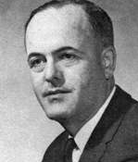
Byte
Byte: Basic unit of computation and storage
The term is coined by Werner Buchholz (IBM).
Byte sizes from 1 bit to 48 bits have been used in the history
Notes:
Why byte?

Slide 14
Byte
1010
CPU
1101
Arithmetic Logic Unit
0011
1010
0011
1000
0000
Memory is a continuous array.
Each unit is a byte.
1111
0100
Memory
1 Byte is the smallest information
CPU can fetch from memory
(One cannot fetch just 1 bit)
Notes:
Why byte?

Slide 15
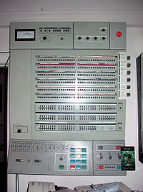
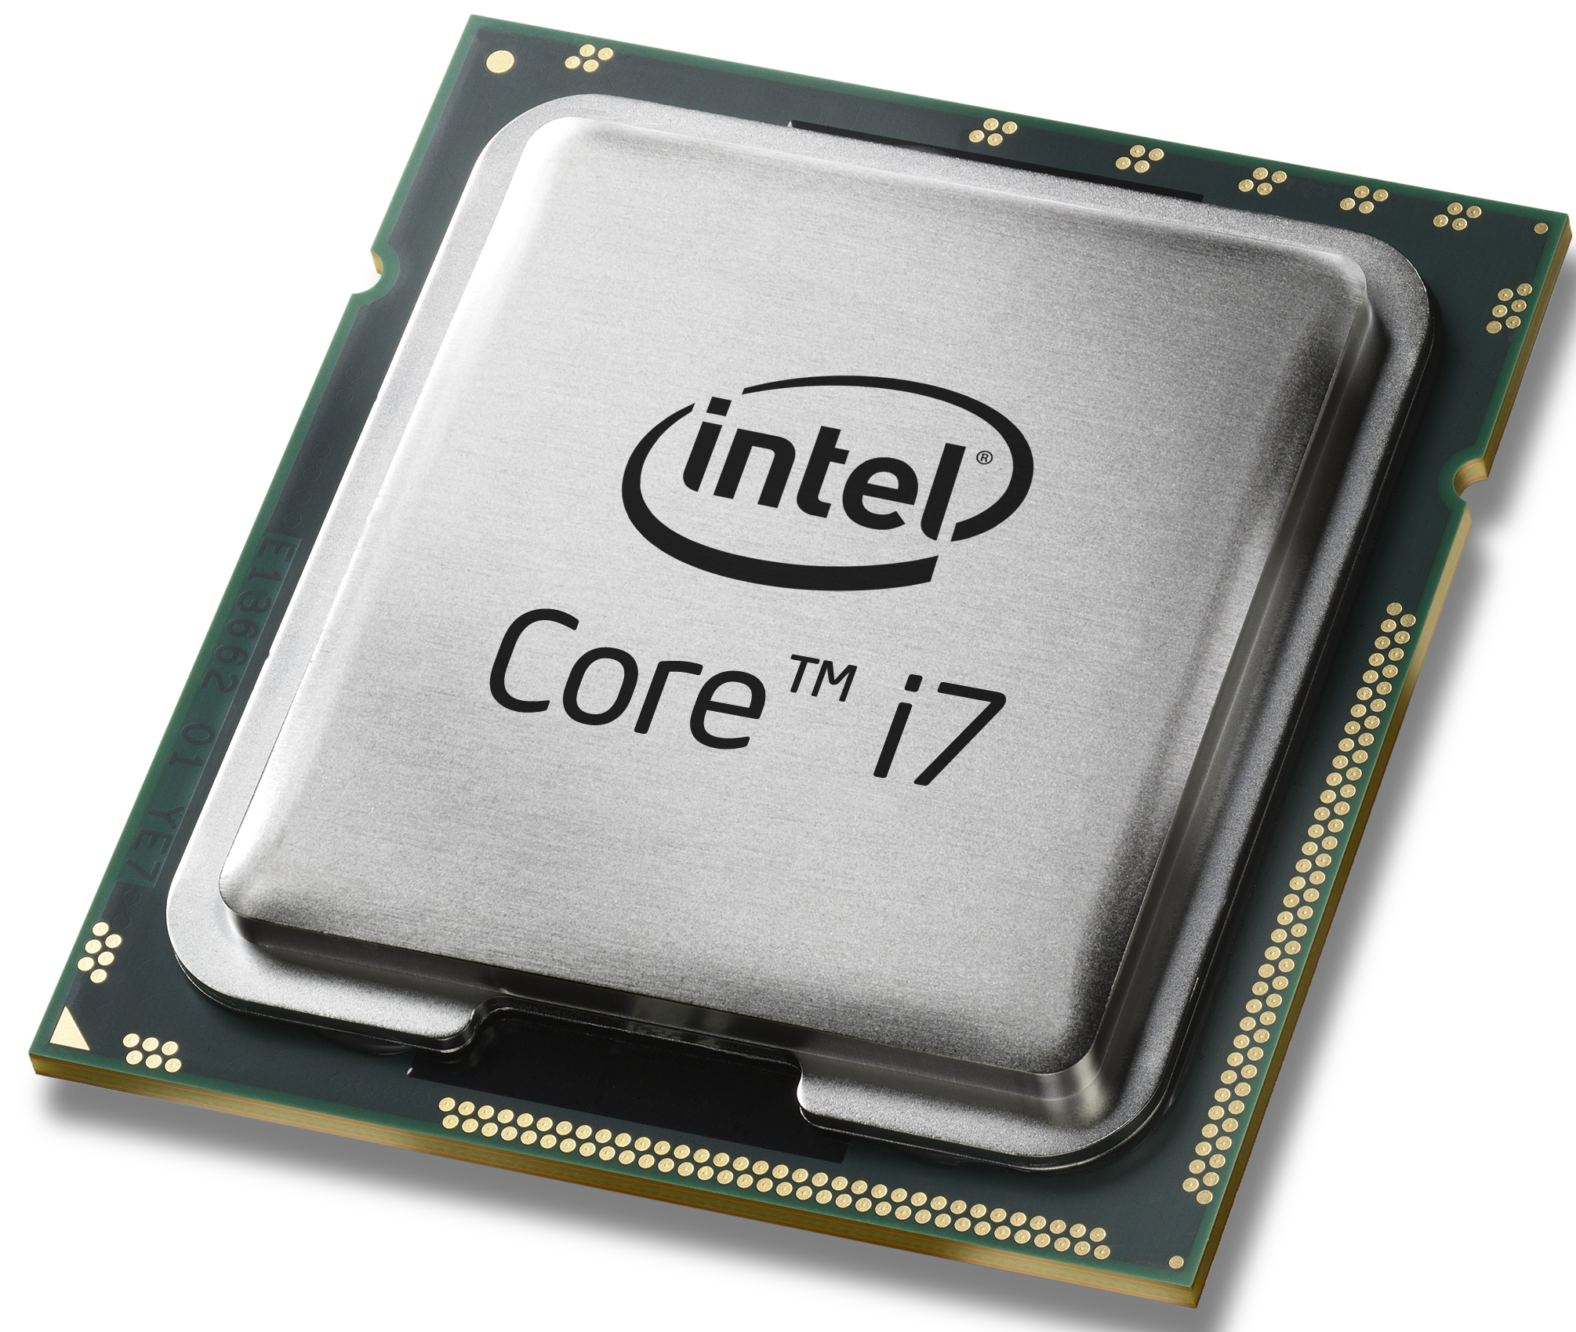
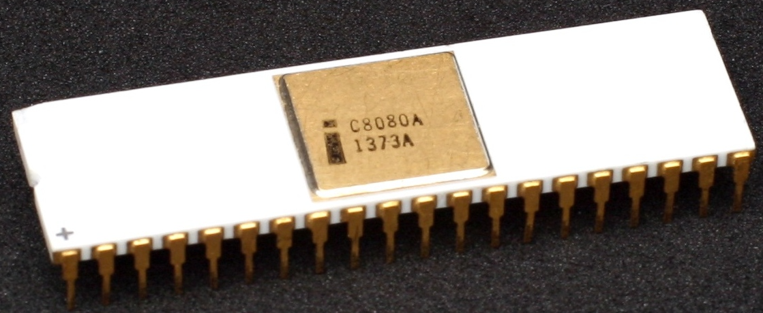
Byte – 8 bits chunk
IBM System/360, 1964
Intel 8080, 1974
Modern processors
Introduced
Widely adopted
Standardized
Notes:
Why byte?

Slide 16
Your mental model
addresses
addr₁
addr₄
00011010
CPU
addr₃
00001110
10101110
Arithmetic Logic Unit
addresses
addr₂
11001010
addr₁
10101110
......
Memory
Each byte has 8 bits
Notes:
Why byte?

Slide 17
Range of a single byte as non-negative integers
Maximum
Minimum
11111111₂ → 255
00000000₂ → 0

Slide 18
Range of 4-byte as non-negative integers
Maximum
Minimum
11111111…1₂ → 2³²-1
00000000…0₂ → 0

Slide 19
Describing a bit pattern – intuitive way
How to make a bit pattern human readable?
Use base-2 notation?
Bits 10101110 11001010 00001110 00011010
4 bytes
15 cm on my laptop

Slide 20
Describing a bit pattern – strawman
How to make a bit pattern human readable?
Use base-2 notation? Too verbose
Use base-10 notation?
How many decimal digits needed
to represent 1 byte?
3
Bits 10101110 11001010 00001110 00011010
Decimal 174 202 014 026
Conversion from base-2 to base-10 (and vice versa)
is mentally difficult for humans

Slide 21
Describing a bit pattern- Hex Notation
Use base-16 (hexadecimal) notation
Hex “digit” is one of 16 symbols: 0-9, a,b,c,d,e,f
How many bits needed to represent a hex digit?
4

Slide 22
Hexadecimal “digit”
Decimal
Hex
Binary
0
0
0000
1
1
0001
2
2
0010
3
3
0011
4
4
0100
5
5
0101
6
6
0110
7
7
0111
8
8
1000
9
9
1001
A
10
1010
B
11
1011
C
12
1100
D
13
1101
E
14
1110
F
15
1111

Slide 23
Hex Notation
1 byte = 8 bits = 2 hex digits
Bits 10101110 11001010 00001110 00011010
Decimal 174 202 014 026
Hex
Hex(C)
1010 =

Slide 24
Hexadecimal Notation
1 byte = 8 bits = 2 hex digits
Bits 10101110 11001010 00001110 00011010
Decimal 174 202 014 026
Hex A
Hex(C)
1010 = 1 * 2³ + 0 * 2² + 1 * 2 + 0 = 10 = A₁₆

Slide 25
Hexadecimal Notation
1 byte = 8 bits = 2 hex digits
Bits 10101110 11001010 00001110 00011010
Decimal 174 202 014 026
Hex A
Hex(C)
1110 =

Slide 26
Hexadecimal Notation
1 byte = 8 bits = 2 hex digits
Bits 10101110 11001010 00001110 00011010
Decimal 174 202 014 026
Hex A E
Hex(C)
1110 = 1 * 2³ + 1 * 2² + 1 * 2 + 0 = 14 = E₁₆

Slide 27
Hexadecimal Notation
1 byte = 8 bits = 2 hex digits
Bits 10101110 11001010 00001110 00011010
Decimal 174 202 014 026
Hex A E
Hex(C)
1100 =

Slide 28
Hexadecimal Notation
1 byte = 8 bits = 2 hex digits
Bits 10101110 11001010 00001110 00011010
Decimal 174 202 014 026
Hex A E C
Hex(C)
1100 = 1 * 2³ + 1 * 2² + 0 * 2 + 0 = 12 = C₁₆

Slide 29
Hexadecimal Notation
1 byte = 8 bits = 2 hex digits
Bits 10101110 11001010 00001110 00011010
Decimal 174 202 014 026
Hex A E C
Hex(C)
1010 =

Slide 30
Hexadecimal Notation
1 byte = 8 bits = 2 hex digits
Bits 10101110 11001010 00001110 00011010
Decimal 174 202 014 026
Hex A E C A
Hex(C)
1010 = 1 * 2³ + 0 * 2² + 1 * 2 + 0 = 10 = A₁₆

Slide 31
Hexadecimal Notation
1 byte = 8 bits = 2 hex digits
Bits 10101110 11001010 00001110 00011010
Decimal 174 202 014 026
Hex A E C A 0
Hex(C)
0000 = 0 * 2³ + 0 * 2² + 0 * 2 + 0 = 0 = 0₁₆

Slide 32
Hexadecimal Notation
1 byte = 8 bits = 2 hex digits
Bits 10101110 11001010 00001110 00011010
Decimal 174 202 014 026
Hex A E C A 0 E
Hex(C)
1110 = 1 * 2³ + 1 * 2² + 1 * 2 + 0 = 14 = E₁₆

Slide 33
Hexadecimal Notation
1 byte = 8 bits = 2 hex digits
Bits 10101110 11001010 00001110 00011010
Decimal 174 202 014 026
Hex A E C A 0 E 1
Hex(C)
0001 = 0 * 2³ + 0 * 2² + 0 * 2 + 1 = 1 = 1₁₆

Slide 34
Hexadecimal Notation
1 byte = 8 bits = 2 hex digits
Bits 10101110 11001010 00001110 00011010
Decimal 174 202 014 026
Hex A E C A 0 E 1 A
Hex(C)
1010 = 1 * 2³ + 0 * 2² + 1 * 2 + 0 = 10 = A₁₆

Slide 35
Hexadecimal Notation
Each byte is represented with 2 hex numbers (00₁₆ -- FF₁₆)
Bits 10101110 11001010 00001110 00011010
Decimal 174 202 014 026
Hex A E C A 0 E 1 A
Hex(C) 0xAECA0E1A

Slide 36
Exercises Time
Hexadecimal | Decimal | Binary
 |  | 1010 0111
 |  | 0011 1110
0xBC
 | 55
0xF3

Slide 37
Answers
Hexadecimal | Decimal | Binary
0xA7 | 10*16 + 7 = 167 | 1010 0111
0x3E | 3*16 + 14 = 62 | 0011 1110
0xBC | 11*16 + 12 = 188 | 1011 1100
0x37 | 3*16+7=55 | 0011 0111
0xF3 | 15*16+3=243 | 1111 0011

Slide 38



Unsigned addition
11 + 10
00001011₂ + 00001010₂

Slide 39
Unsigned addition
11 + 10
00001011₂ + 00001010₂
0 0 0 0 1 0 1 1
+
0 0 0 0 1 0 1 0

Slide 40
Unsigned addition
11 + 10
00001011₂ + 00001010₂
0 0 0 0 1 0 1 1
+
0 0 0 0 1 0 1 0
1

Slide 41
Unsigned addition
11 + 10
00001011₂ + 00001010₂
0 0 0 0 1 0 1 1
+
0 0 0 0 1 0 1 0
2 1

Slide 42
Unsigned addition
11 + 10
00001011₂ + 00001010₂
1
0 0 0 0 1 0 1 1
+
0 0 0 0 1 0 1 0
0 1

Slide 43
Unsigned addition
11 + 10
00001011₂ + 00001010₂
1
0 0 0 0 1 0 1 1
+
0 0 0 0 1 0 1 0
1 0 1

Slide 44
Unsigned addition
11 + 10
00001011₂ + 00001010₂
0 0 0 0 1 0 1 1
+
0 0 0 0 1 0 1 0
0 0 0 1 0 1 0 1

Slide 45
Unsigned subtraction
11 - 10
00001011₂ - 00001010₂
0 0 0 0 1 0 1 1
-
0 0 0 0 1 0 1 0

Slide 46
Unsigned subtraction
11 - 10
00001011₂ - 00001010₂
0 0 0 0 1 0 1 1
-
0 0 0 0 1 0 1 0
0 0 0 0 0 0 0 1

Slide 47
Unsigned subtraction
10-11
00001010₂ - 00001011₂
0 0 0 0 1 0 1 0
-
0 0 0 0 1 0 1 1
? ? ?

Slide 48
Question:
How to represent negative numbers?

Slide 49
Strawman
Most significant bit (MSB) represents the sign
0 0 0 0 0 0 0 1₂
1
1 0 0 0 0 0 0 1₂
-1
0 0 0 0 0 0 0 1
+
1 0 0 0 0 0 0 1

Slide 50
Strawman
Most significant bit (MSB) represents the sign
0 0 0 0 0 0 0 1₂
1
1 0 0 0 0 0 0 1₂
-1
0 0 0 0 0 0 0 1
+
1 0 0 0 0 0 0 1
1 0 0 0 0 0 1 0

Slide 51

Strawman
Most significant bit (MSB) represents the sign
0 0 0 0 0 0 0 1₂
1
1 0 0 0 0 0 0 1₂
-1
0 0 0 0 0 0 0 1
+
1 0 0 0 0 0 0 1
1 0 0 0 0 0 1 0
-2 ???

Slide 52
Two’s complement
Byte 10010110
Unsigned number
1 * 2⁷ + 0 * 2⁶ + 0 * 2⁵ + 1 * 2⁴ + 0 * 2³ + 1 * 2² + 1 * 2 + 0 * 2⁰

Slide 53
Two’s complement
Byte 10010110
Unsigned number
1 * 2⁷ + 0 * 2⁶ + 0 * 2⁵ + 1 * 2⁴ + 0 * 2³ + 1 * 2² + 1 * 2 + 0 * 2⁰
Signed number
-1 * 2⁷ + 0 * 2⁶ + 0 * 2⁵ + 1 * 2⁴ + 0 * 2³ + 1 * 2² + 1 * 2 + 0 * 2⁰

Slide 54
Two’s complement
MSB: val( b_{w} ) = -b_{w} * 2^{w}
Other: val ( b_{i} ) = b_{i} * 2^{i}, 0 <= i < w

Slide 55
Two’s complement
Binary |  | Value
1000 0001
1010 0101
0101 0101

Slide 56
Two’s complement
Binary |  | Value
1000 0001 | -1 * 2⁷ + 1 | -127
1010 0101
0101 0101

Slide 57
Two’s complement
Binary |  | Value
1000 0001 | -1 * 2⁷ + 1 | -127
1010 0101 | -1 * 2⁷ + 2⁵ + 2² + 2⁰ | -91
0101 0101

Slide 58
Two’s complement
Binary |  | Value
1000 0001 | -1 * 2⁷ + 1 | -127
1010 0101 | -1 * 2⁷ + 2⁵ + 2² + 2⁰ | -91
0101 0101 | 2⁶ + 2⁴ + 2² + 2 | 85

Slide 59
Two’s complement
0 0 0 0 0 0 0 1
+
1 0 0 0 0 0 0 1
1 0 0 0 0 0 1 0

Slide 60
Two’s complement
0 0 0 0 0 0 0 1
2⁰
1
+
1 0 0 0 0 0 0 1
-1 * 2⁷ + 2⁰
-127
1 0 0 0 0 0 1 0
-1 * 2⁷ + 2¹
-126

Slide 61
Find 2’s complement quickly
With a negative number, how to give its binary representation? e.g. -40

Slide 62
Find 2’s complement quickly
With a negative number, how to give its binary representation? e.g. -40
Step 1. represent 40 in binary
0010 1000

Slide 63
Find 2’s complement quickly
With a negative number, how to give its binary representation? e.g. -40
Step 2. flip all bits
0010 1000
1101 0111

Slide 64
Find 2’s complement quickly
With a negative number, how to give its binary representation? e.g. -40
Step 3. add 1
0010 1000
1101 0111
1101 1000

Slide 65
Find 2’s complement quickly
With a negative number, how to give its binary representation? e.g. -40
Step 3. add 1
0010 1000
1101 0111
1101 1000

Slide 66
Find 2’s complement quickly
With a negative number, how to give its binary representation? e.g. -40
Step 3. add 1
0010 1000
1101 0111
1101 1000

Slide 67
Why does this trick work
What is 1111...11₂ in 2’s complement?
b with bits flipped

Slide 68
Exercise Time II
Hexadecimal | Decimal | Binary
0xce
 |  | 1001 1100
 | 127
 | -128
 | -90

Slide 69
Answers
Hexadecimal | Decimal | Binary
0xce | -50 | 1100 1110
0x9c | -100 | 1001 1100
0x7f | 127 | 0111 1111
0x80 | -128 | 1000 0000
0xa6 | -90 | 1010 0110

Slide 70
Ranges
 | Range | Min | Max
1 byte unsigned | [0, 2⁸ – 1] | 0 | 255
1 byte signed

Slide 71
Ranges
 | Range | Min | Max
1 byte unsigned | [0, 2⁸ – 1] | 0 | 255
1 byte signed | [-2⁷, 2⁷ – 1] | -128 | 127
Min: 1000 0000
Max: 0111 1111

Slide 72
Overflow
1 0 0 0 0 0 0 1
-127
+
1 0 0 0 0 0 0 1
-127
 | Range | Min | Max
1 byte unsigned | [0, 2⁸ – 1] | 0 | 255
1 byte signed | [-2⁷, 2⁷ – 1] | -128 | 127

Slide 73
Overflow
1 0 0 0 0 0 0 1
-127
+
1 0 0 0 0 0 0 1
-127
1
0 0 0 0 0 0 1 0
2 ???
carry bit discarded
 | Range | Min | Max
1 byte unsigned | [0, 2⁸ – 1] | 0 | 255
1 byte signed | [-2⁷, 2⁷ – 1] | -128 | 127

Slide 74
Intel 8080
0xb0
0x0f
CPU
0xa9
0xaf
Arithmetic Logic
Unit
0xa8
0x1e
0xa7
0x4c
registers
0x4c
0x4c
0xa6
0xea
0xa5
0xcb
0xa4
0xba
0xa3
0x00
0xa2
0xff
0xa1
0x8c
…
……
Memory

Slide 75
Intel 8080 (1974)
0xb0
0x0f
CPU
0xa9
0xaf
Arithmetic Logic
Unit
0xa8
0x1e
0xa7
0x4c
registers
0x4c
0x4c
0xa6
0xea
0xa5
0xcb
0xa4
0xba
0xa3
0x00
8 bits machine – 8 bits length of
Memory – processor transfer
CPU Register
Memory Address
0xa2
0xff
0xa1
0x8c
…
……
Memory

Slide 76
Intel 386 (1985)
0x000000b0
0x0f
CPU
0x000000a9
0xaf
Arithmetic Logic
Unit
0x000000a8
0x1e
0x000000a7
0x4c
registers
0x4c1eaf0f
0x4c1eaf0f
0x000000a6
0xea
0x000000a5
0xcb
0x000000a4
0xba
0x000000a3
0x00
32 bits machine – 32 bits length of
Memory – processor transfer
CPU Register
Memory Address
0x000000a2
0xff
0x000000a1
0x8c
…
……
Memory

Slide 77
AMD K8 (2000), Intel Pentium 4 and later
0x00…00b0
0x0f
CPU
0x00…00a9
0xaf
0x1e
Arithmetic Logic Unit
0x00…00a8
0x00…00a7
0x4c
registers
0x00bacbea4c1eaf0f
0x00…00a6
0xea
0x00…00a5
0xcb
0x00bacbea4c1eaf0f
0x00…00a4
0xba
0x00…00a3
0x00
64 bits machine – 64 bits length of
Memory – processor transfer
CPU Register
Memory Address
0x00…00a2
0xff
0x00…00a1
0x8c
…
……
Memory

Slide 78
Intel Opteron → i7
0x00…00b0
0x0f
CPU
0x00…00a9
0xaf
0x1e
Arithmetic Logic Unit
0x00…00a8
0x00…00a7
0x4c
registers
0x00bacbea4c1eaf0f
0x00…00a6
0xea
0x00…00a5
0xcb
0x00bacbea4c1eaf0f
0x00…00a4
0xba
0x00…00a3
0x00
Word
Memory – processor transfer
CPU Register
Memory Address
0x00…00a2
0xff
0x00…00a1
0x8c
…
……
Memory

Slide 79
Word
Definition
Fixed size of data handled as a unit by the instruction set or processor
Length
8 for 8 bits machine
32 for 32 bits machine
64 for 64 bits machine

Slide 80
Wrapping up last lecture
What you have learnt:
information as bits
byte: 8-bit
how to represent unsigned/signed integer
Computers use fixed-width representation (1, 2, 4, 8 bytes)
overflow
32-bit vs. 64-bit computer architecture
Wrapping up:
C’s integer data types
How multi-byte integers are stored in memory

Slide 81
C’s integral data types on 64 bits machine
 | Length | Min | Max
[signed] char | 1 byte | -2⁷ | 2⁷ - 1
unsigned char | 1 byte | 0 | 2⁸ - 1
short | 2 bytes
unsigned short | 2 bytes
int | 4 bytes
unsigned int | 4 bytes
long | 8 bytes
unsigned long | 8 bytes

Slide 82
Integral data types on 64 bits machine
 | Length | Min | Max
[signed] char | 1 byte | -2⁷ | 2⁷ - 1
unsigned char | 1 byte | 0 | 2⁸ - 1
short | 2 bytes | -2¹⁵ | 2¹⁵ - 1
unsigned short | 2 bytes | 0 | 2¹⁶ - 1
int | 4 bytes
unsigned int | 4 bytes
long | 8 bytes
unsigned long | 8 bytes

Slide 83
Integral data types on 64 bits machine
 | Length | Min | Max
[signed] char | 1 byte | -2⁷ | 2⁷ - 1
unsigned char | 1 byte | 0 | 2⁸ - 1
short | 2 bytes | -2¹⁵ | 2¹⁵ - 1
unsigned short | 2 bytes | 0 | 2¹⁶ - 1
int | 4 bytes | -2³¹ | 2³¹ - 1
unsigned int | 4 bytes | 0 | 2³² - 1
long | 8 bytes
unsigned long | 8 bytes

Slide 84
Integral data types on 64 bits machine
 | Length | Min | Max
[signed] char | 1 byte | -2⁷ | 2⁷ - 1
unsigned char | 1 byte | 0 | 2⁸ - 1
short | 2 bytes | -2¹⁵ | 2¹⁵ - 1
unsigned short | 2 bytes | 0 | 2¹⁶ - 1
int | 4 bytes | -2³¹ | 2³¹ - 1
unsigned int | 4 bytes | 0 | 2³² - 1
long | 8 bytes | -2⁶³ | 2⁶³ - 1
unsigned long | 8 bytes | 0 | 2⁶⁴ - 1

Slide 85
Your first C program
#include <stdio.h>
int
main()
{
char x = -127;
char y = 0x81;
char z = x + y;
printf(“hello world sum is %d\n”, z);
}
$ gcc helloworld.c
$ ./a.out
1 0 0 0 0 0 0 1
-127
+
1 0 0 0 0 0 0 1
-127
1
0 0 0 0 0 0 1 0
2

Slide 86
Memory layout for multi-byte integers
0x00…00b0
CPU
0x00…00a9
Arithmetic Logic Unit
0x00…00a8
0x00…00a7
registers
…
0x00…00a6
0x00…00a5
0x00…00a4
0x00…00a3
int a = 0x12345678
0x00…00a2
int a
address: 0x00…00a2
0x00…00a1
…
……
Memory

Slide 87
Memory layout for multi-byte integers: 2 ways
0x00…00b0
CPU
0x00…00a9
Arithmetic Logic Unit
0x00…00a8
0x00…00a7
registers
…
0x00…00a6
0x00…00a5
0x78
0x00…00a4
0x56
0x00…00a3
0x34
int a = 0x12345678
0x00…00a2
0x12
int a
address: 0x00…00a2
0x00…00a1
…
……
Memory

Slide 88
Memory layout for multi-byte integers: 2 ways
0x00…00b0
CPU
0x00…00a9
Arithmetic Logic Unit
0x00…00a8
0x00…00a7
registers
…
0x00…00a6
0x00…00a5
0x12
0x00…00a4
0x34
0x00…00a3
0x56
int a = 0x12345678
0x00…00a2
0x78
int a
address: 0x00…00a2
0x00…00a1
…
……
Memory

Slide 89
Memory layout – Little Endian
0x00…00b0
CPU
0x00…00a9
Arithmetic Logic Unit
0x00…00a8
0x00…00a7
registers
…
0x00…00a6
0x00…00a5
0x12
0x00…00a4
0x34
int a = 0x12345678
0x00…00a3
0x56
address: 0x00…00a2
0x00…00a2
0x78
int a
0x00…00a1
Least significant byte in smallest address,
e.g, laptops, and server machines
…
……
Memory

Slide 90
Advantages of Little Endian
0x12345678
Processor performs the calculation
from the least significant bit
+
0x12131415
Processor can simultaneously
perform memory transfer and
calculation.

Slide 91
Advantages of Little Endian
0x00…00b0
CPU
0x00…00a9
Arithmetic Logic Unit
0x00…00a8
0x00…00a7
registers
…
0x00…00a6
0x00…00a5
int a = 0x12345678
0x00…00a4
address of variable a: 0x00…00a2
0x00…00a3
0x00…00a2
int a
0x00…00a1
…
……
Memory

Slide 92
Advantages of Little Endian
0x00…00b0
CPU
0x00…00a9
Arithmetic Logic Unit
0x00…00a8
0x00…00a7
registers
…
0x00…00a6
0x00…00a5
0x12
int a = 0x12345678
0x00…00a4
0x34
address: 0x00…00a2
0x00…00a3
0x56
0x00…00a2
0x78
int a
0x00…00a1
…
……
Memory

Slide 93
Advantages of Little Endian
0x00…00b0
CPU
0x00…00a9
Arithmetic Logic Unit
0x00…00a8
0x00…00a7
registers
…
0x00…00a6
0x00…00a5
0x12
int a = 0x12345678
0x00…00a4
0x34
address: 0x00…00a2
0x00…00a3
0x56
0x00…00a2
0x78
int a
short b
0x00…00a1
short b = (short)a
…
……
Directly get the data from
0x00…00a2
Memory

Slide 94
Memory layout – Big Endian
0x00…00b0
CPU
0x00…00a9
Arithmetic Logic Unit
0x00…00a8
0x00…00a7
registers
…
0x00…00a6
0x00…00a5
0x78
int a = 0x12345678
0x00…00a4
0x56
0x00…00a3
0x34
address: 0x00…00a2
0x00…00a2
0x12
int a
0x00…00a1
Most significant byte in smallest address,
e.g, ARM architecture >v3 (cellphones, ipads)
…
……
Memory

Slide 95
Advantages of Big Endian
Test whether the number is positive or negative by looking at the byte at offset zero.

